Slide 1
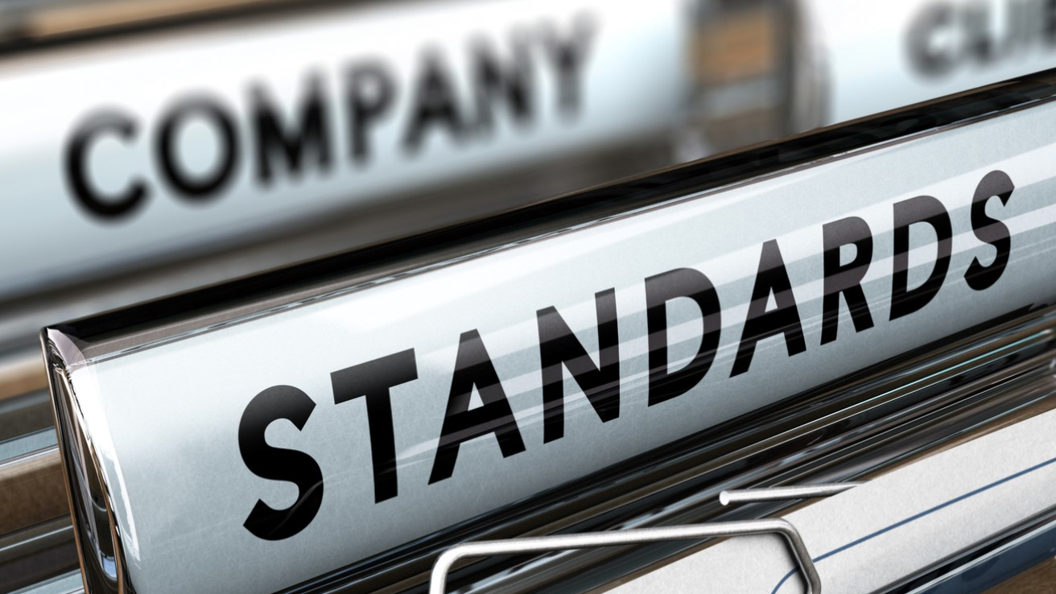
Compliance

Slide 2
ISO 27000 series
PCI-DSS
Provides more detailed instructions than most other best practices but not much breadth
ISO 27000 Series
Comprehensive standard providing best practices associated with each control
PCI-DSS
NIST SP800-53
COBIT 5 for Security
More principle and process-based than other best practices
NIST SP800 Series
Provides a detailed list of security controls along with many implementation best practices intended for federal information systems and organizations
COBIT 5
SANS Twenty Critical Security Controls
Provides a great list of controls for effective cyber defence
SANS Critical Controls

Slide 3
Context and Leadership
Evaluation and Direction
Compliance, Audit and Review
Information Security Charter
Security Risk Management
Security Compliance Management
Information Security Organizational Structure
External Security Audit
Governance
Security Policies
Internal Security Audit
Culture and Awareness
Security Strategy and Communication
Management Review of Security
Prevention
Identity Security
Infrastructure Security
Response and Recovery
Identity and Access Management
Network Security
Vulnerability Management
Security Incident Management
Information Security Framework
Endpoint Security
Cryptography Management
Data Security
Information Security in BCM
Hardware Asset Management
Malicious Code
Physical Security
Security eDiscovery and Forensics
Data Security & Privacy
Application Security
Cloud Security
Backup and Recovery
Management
Change and Support
HR Security
Configuration and Change Management
HR Security
Measurement
Vendor Management
Metrics Program
Detection
Continuous Improvement
Security Threat Detection
Log and Event Management

Slide 4
Types of Data
Compliance is data rather than system or process focused.
This is where we get the concept of sensitive data. Some data must be protected to certain standards due to federal regulations.
Data is often audited by a qualified person to determine whether or not the storage, use, and transmission of sensitive data is in compliance with the applicable policies and regulations.
Compliance does not equal security!!

Slide 5
Areas of Concern
Statutory
Regulatory
Obligatory
Administrative
Organizational

Slide 6
Areas of Concern
State laws:
Wis. Stat. §134.98 – Data breach notification
Wis. Stat. §995.50 - Privacy
Federal laws:
15 U.S.C. § 98 – Sarbanes-Oxley (SOX)
15 U.S.C. Sub Ch I – Graam-Leach-Bliley, GLBA
15 U.S. Code Chapter 91 – COPPA
18 U.S. Code Chapter 119 - ECPA
18 U.S. Code Chapter 121 – SCA
International laws:
General Data Protection Regulation (GDPR) - Regulation (EU) 2016/679 of the European Parliament and of the Council of 27 April 2016
Statutory

Slide 7
Areas of Concern
State laws:
Wis. Stat. §601.465 – New this month!
Federal laws:
110 US U.S.C. § 1936 – HIPAA (Healthcare)
20 U.S.C. § 1232g – FERPA (Education)
Regulatory

Slide 8
Areas of Concern
Contractual:
PCI
EULA
ToS
SLAs
Licensing
Requisite
Defense Federal Acquisition Regulation
Cybersecurity Maturity Model
IoT Cybersecurity Improvement Act 2020
Various FEC / SEC privacy/security rules (enforced by self-regulatory bodies like FINRA)
Obligatory

Slide 9
Areas of Concern
Bureaucratic:
Administrative areas dictate compliance requirements.
Generally, in favor of or reinforcing the administrative functions of the bureaucracy.
Adherence leads to more centralization, smoother operations.
Administrative

Slide 10
Areas of Concern
Operational:
Requirements that ensure consistent operation or procedure.
Requirements to ensure all objectives are achieved efficiently and orderly.
Institutional:
Rules issued by leadership to ensure agility in the face of change.
Requirements to achieve a strategic or tactical organizational objective.
Organizational

Slide 11

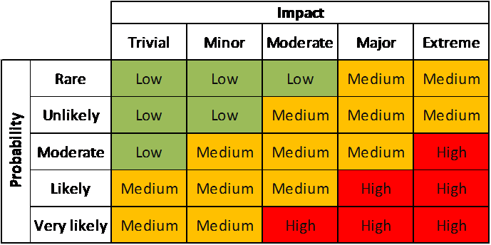
Risks: Probability and Impact
Probability
How much motivation does an attacker have to try to exploit my system?
How securely have I protected my system?
Impact
How damaging is a potential attack on my system?
Types of impact: Financial, Health and Safety, Personal, Service Interruption
Risk Matrix

Slide 12
Risk Assessment: Target Breach
Case: Attackers breached Target’s network through a heating and air conditioning (HVAC) company and point-of-sale systems to steal 40 million credit card numbers

Slide 13
Risk Assessment: Target Breach
Probability: Likely
Attackers knew that Target has a massive network with many potential holes and that they could gain a wealth of information
Network was not fully secured; HVAC company had open access to it

Slide 14
Risk Assessment: Target Breach
Impact: Major
Loss of financial information could have major impact on Target’s customers
Breach was a huge embarrassment to Target and could have led to decrease in future sales

Slide 15
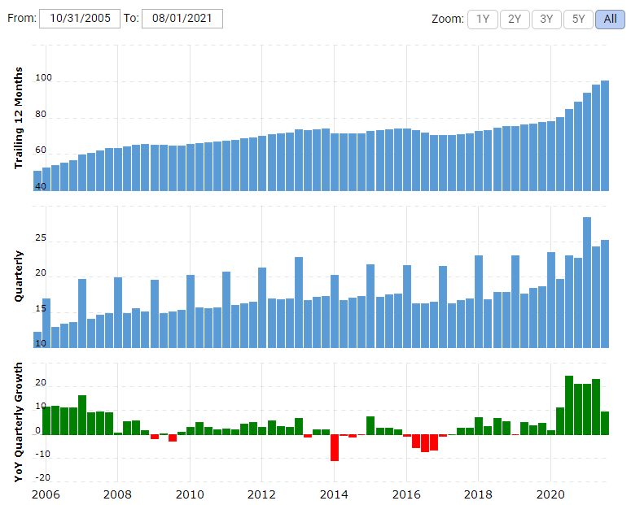
Risk Assessment: Target Breach
Long Term Damage?
Target is still around. Doing better than ever.
Short Term Damage?
Outside of cybersecurity circles none.
The lesson: Compliance doesn’t protect organizations. It’s mean to protect people.

Slide 16
Risks
Risk
Malicious
Accidental
Force Majeure
Compliance

Slide 17
Pros and Cons of Compliance
Pros:
Applies to data instead of systems.
Applies equally to all organizations – small, medium, or large.
Provides a minimum acceptable standard.
Auditable standards and third-party oversight.
Cons:
Not all systems are equal or as capable.
Some organizations are more equal and others.
Minimum standards often fall short of security.
Increased labor/opportunity/monetary cost.

Slide 18
Types of Data - PII
PII – The most common form of sensitive data is Personally Identifiable Information. In short, information that could be used to identify an individual if applied to a set of individuals. I know that seems tautological, so let me put it this way…
I am an individual. (1 of 7.3 billion people.)
I live in the United States (1 of 326 million people.)
My name is Chad Johnson (1 of 269,848 people.)
My name is Chad Johnson and I live in the US (1 of 1,858 people.)
My Social Security Number is NUNYA BEESWAX (1 of 1 people.)

Slide 19
Types of Data - PII
HOWEVER – not all PII is sensitive. There are some types of information that are self-evident – that are so specific to one person that they can be used by themselves to identify an individual. Some PII is non-sensitive, but could be used if enough is present or in conjunction with other information to specifically identify a person.
Data that is automatically sensitive PII is known as axiomatic PII.
Data that is not automatically sensitive PII is known as demonstrable PII.

Slide 20
PCI
FERPA
PII
CHD
Education Records
HIPAA
PHI

Slide 21
Types of data - PCI
Cardholder Data (CHD) – Generally the info on the front of the card. Nothing in PCI DSS forbids storage of this data.
Primary Account Number (PAN)
Truncated PAN: up to first 6 and last 4
Cardholder Name (when kept with PAN)
Expiration Date (when kept with PAN)
Service Code (when kept with PAN)
Sensitive Authentication Data (SAD) – Generally on the back of the card. NEVER STORE SAD after authorization.
Full magnetic stripe data or equivalent on a chip
CAV2/CVC2/CVV2/CID
PIN/PIN block

Slide 22
Types of Data - PCI
PCI also certifies auditors. ISA are internal security assessors. QSA (qualified security assessors) are external auditors, outsourcing the compliance audit.
A QSA can:
Validate scope of compliance
Prepare gap assessments
Perform a full PCI assessment
And prepare the Report on Compliance (ROC)
Assist with the Attestation of Compliance (AOC)

Slide 23
Types of Data - FERPA
The Family Educational Rights and Privacy Act (FERPA) (20 U.S.C. § 1232g; 34 CFR Part 99) is a Federal law that protects the privacy of student education records.
The law applies to all schools that receive funds under an applicable program of the U.S. Department of Education.
FERPA gives parents certain rights with respect to their children's education records.
These rights transfer to the student when he or she reaches the age of 18 or attends a school beyond the high school level. Students to whom the rights have transferred are "eligible students."

Slide 24
Types of Data - FERPA
Parents or eligible students have the right to inspect and review the student's education records maintained by the school.
Schools are not required to provide copies of records unless, for reasons such as great distance, it is impossible for parents or eligible students to review the records. Schools may charge a fee for copies.
Except for Wisconsin, because…. WI 19 – Open Records Law

Slide 25
Types of Data - FERPA
Parents or eligible students have the right to request that a school correct records which they believe to be inaccurate or misleading.
If the school decides not to amend the record, the parent or eligible student then has the right to a formal hearing.
After the hearing, if the school still decides not to amend the record, the parent or eligible student has the right to place a statement with the record setting forth his or her view about the contested information.

Slide 26
Types of Data - GDPR
After four years of preparation and debate the GDPR was finally approved by the EU Parliament on 14 April 2016. Enforcement date: 25 May 2018 - at which time those organizations in non-compliance may face heavy fines.
Breach Notification
Under the GDPR, breach notification will become mandatory in all member states where a data breach is likely to “result in a risk for the rights and freedoms of individuals”. This must be done within 72 hours of first having become aware of the breach. Data processors will also be required to notify their customers, the controllers, “without undue delay” after first becoming aware of a data breach.
Right to Access
Part of the expanded rights of data subjects outlined by the GDPR is the right for data subjects to obtain from the data controller confirmation as to whether or not personal data concerning them is being processed, where and for what purpose. Further, the controller shall provide a copy of the personal data, free of charge, in an electronic format. This change is a dramatic shift to data transparency and empowerment of data subjects.
Right to be Forgotten
Also known as Data Erasure, the right to be forgotten entitles the data subject to have the data controller erase his/her personal data, cease further dissemination of the data, and potentially have third parties halt processing of the data. The conditions for erasure, as outlined in article 17, include the data no longer being relevant to original purposes for processing, or a data subjects withdrawing consent. It should also be noted that this right requires controllers to compare the subjects' rights to "the public interest in the availability of the data" when considering such requests.

Slide 27
Types of Data - HIPAA
This is Title II HIPAA Privacy, Security, and Enforcement. This clause establishes Personal Health Information (PHI).
a patient's name, address, birth date and Social Security number;
an individual's physical or mental health condition;
any care provided to an individual; or
information concerning the payment for the care provided to the individual that identifies the patient, or information for which there is a reasonable basis to believe could be used to identify the patient.
This applies only to data that is not “de-identified”.

Slide 28
Anonymized data
Compliance applies to data, which is PII. If PII is converted to a form where identification is impossible, it is no longer a compliance (or security) concern.
The process is anonymization or de-identification. The process is known as “data sanitization.”
This can be done by redacting the data (rendering the sensitive data unreadable.)
It can be done by replacing the data (using pre-defined placeholders.)
It can be done by use format-preserving masking (replacing data with randomly selected data from a dataset.)
Or it can be done with data-mixing (using the data itself to anonymize data by randomly changing values to like values.)

Slide 29
Copyright
The Digital Millennium Copyright Act is passed in order to fulfill our own obligations under the WIPO World Copyright Act Treaty. There are, however, a few provisos, a few quid pro quos:
Fair use: Commentary, search engines, criticism, parody, news reporting, research, and scholarship.
Fair use does not protect someone from libel/slander/defamation – that’s a separate issue.

Slide 30
Copyright
Grey areas: Abandonware and orphan works.
Abandonware is copyright material, but the holders do not pursue copyright claims. Still infringement, but if it’s old software with no support and of niche interest, it’s not likely to be a problem.
Orphan works are those under copyright, but with no stakeholder listed. With no one on file to enforce the claim, it’s not likely to be a problem.

Slide 31
Run DMCA
The DMCA doesn’t just cover pirating copyrighted works, but also the circumvention of “technological protection measures” that “effectively control access” to such works.
Infringement also includes trademark violations, such as cybersquatting, expanded by the Anti-cybersquatting Consumer Protection Act in 1999. Trademark disputes are actionable under the Lanham Act.

Slide 32
Any port in a storm
It includes a provision for ISPs to act as a “safe harbor” (known as part of the DMCA called the Online Copyright Infringement Liability Limitation Act OCILLA) – It exempts ISPs from liability for infringement as long as they…
Do not interfere with technical measures copyright owners use to protect their works.
Comply and respond promptly to takedown notices.
Not be aware of any infringement prior to the issuance of a takedown notice.

Slide 33
Run DMCA
The broad immunity of the Digital Millennium Copyright Act’s Safe Harbor provision agrees with other provisions other regulations, like Section 230.
But that may not work for intellectual property rights, according to the US Copyright Office report on Section 512.
And certainly had problems with enforcement from nearly every perspective.

Slide 34
Speaking of Section 230
With all of the content hosted online, there surely must be a complicated compliance requirement for web-hosted content, right?

Slide 35


Section 230? Story time
Once upon a time…
Cubby, Inc. v. Compuserve
Stratton Oakmont, Inc. v. Prodigy Services Co.
“And then there was censorship. The forums were heavily moderated. Foul language and heated arguments weren’t allowed. But the censorship grew to not even being able to mention other users by name. In one infamous example, a discussion in a coin collecting forum got nuked because it used the phrase ‘Roosevelt dime.’ Prodigy happened to have a user named Roosevelt Dime.” – David Farquhar

Slide 36
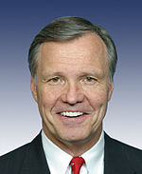
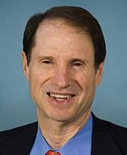
But wait… doesn’t that mean…?
Yep.
“It struck me that if that rule was going to take hold then the internet would become the Wild West and nobody would have any incentive to keep the internet civil.” Christopher Cox (R-CA), 1996

Slide 37
The Communications Decency Act
Section 230 has often been called "The 26 words that made the Internet“
Protection for Good Samaritan blocking and screening of offensive material.
No provider or user of an interactive computer service shall be treated as the publisher or speaker of any information provided by another information content provider.
Publisher vs. distributor
Indemnity does not mean immunity from public opinion.
It also never provided immunity from not responding to illegal material and copyright infringement (hence, Safe Harbor.)

Slide 38
Since 1996…
There have been some developments providing restrictions on content.
Fair Housing Council of San Fernando Valley v. Roommates.com - The site helped to match renters based on a mandatory questionnaire which included information about their race and preferred roommates' race. This created discrimination and violated the Fair Housing Act. Roommates.com was liable for this.
Why did Craigslist dump their online personals and “adult” services section? Or why Backpage.com went down? It wasn’t an attack of conscience. The FOSTA-SESTA bills (the Allow States and Victims to Fight Online Sex Trafficking Act (FOSTA) and the Stop Enabling Sex Traffickers Act (SESTA)) put limitations on section 230.

Slide 39
